Slide 1
Rule Based MT
Dr. Partha Pakray

Slide 2

Four ‘A’ Words
Analysis
Alignment
Analogy
Attention

Slide 3
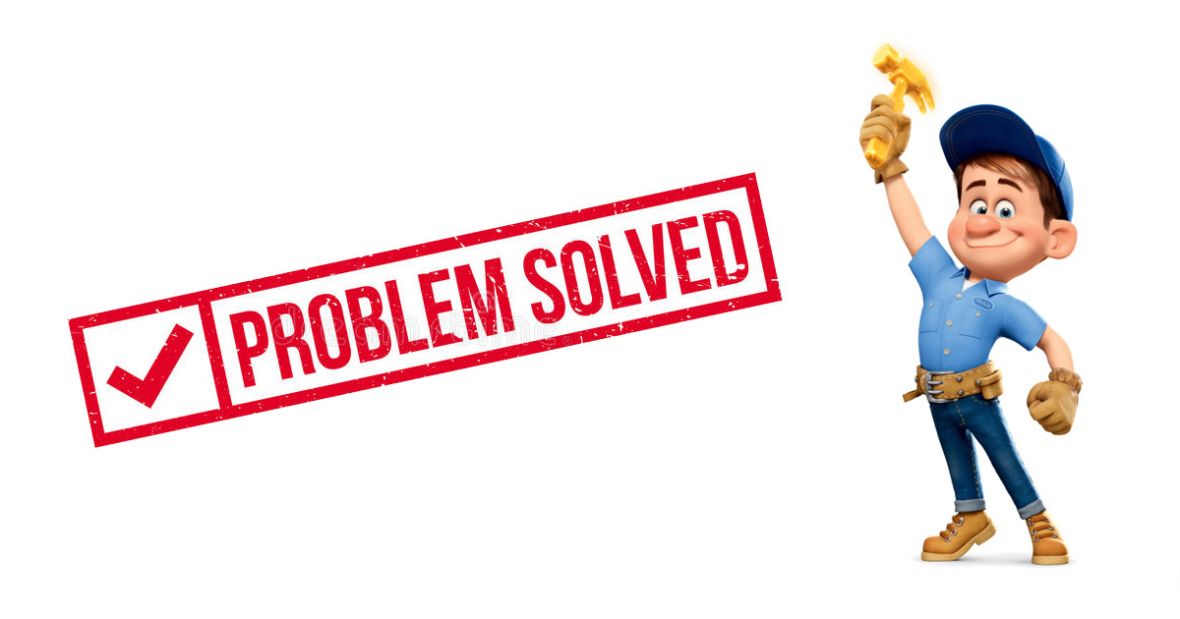
Four ‘A’ Words
Analysis: in RBMT
Alignment: in SMT
Analogy: in EBMT
Attention: in NMT

Slide 4
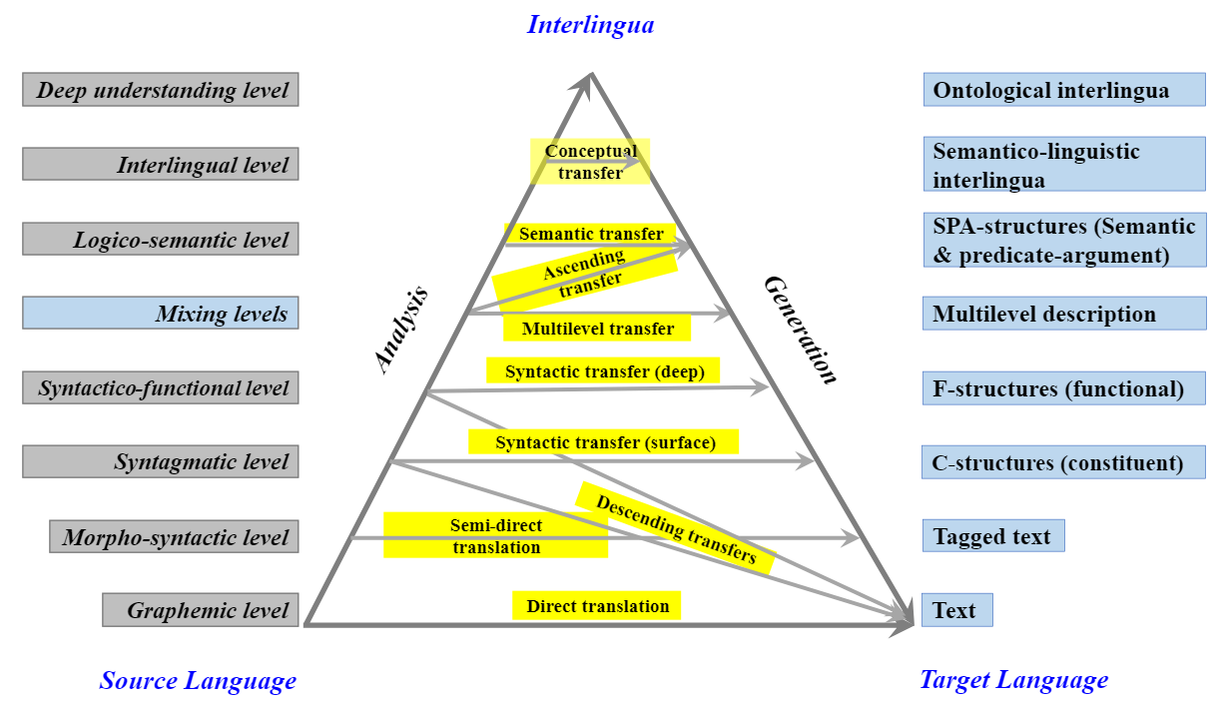

Slide 5
Rule based Machine Translation (RBMT)
Based on “Analysis”.
Source sentence needs to be analysed and converted to a FORM from which the target sentence is generated by
A-T-G
Started at CMU, 1970
Machine translation systems that are based on the use of handcrafted linguistic rules as a knowledge-base are called rule-based MT.

Slide 6
Formation of linguistics rules:
These rules are formed from linguistic information about source and target languages basically retrieved from (bilingual) dictionaries and grammars covering the main morphology, syntactic and semantic regularities of each language respectively
Other names:
Knowledge-based Machine Translation
Classical Approach of MT

Slide 7
Problems with rule-based MT system
This approach is very expensive to build, requiring the manual entry of large numbers of "rules"
Trained linguists are needed
This approach does not scale up well to a general system
Translations are awkward and hard to understand
Complex grammar, large dictionaries are needed
Slow and costly development

Slide 8
Types of RBMT Systems
Dictionary based MT System
Transfer RBMT Systems (Transfer Rule Based Machine Translation)
Interlingual RBMT Systems (Interlingua)

Slide 9
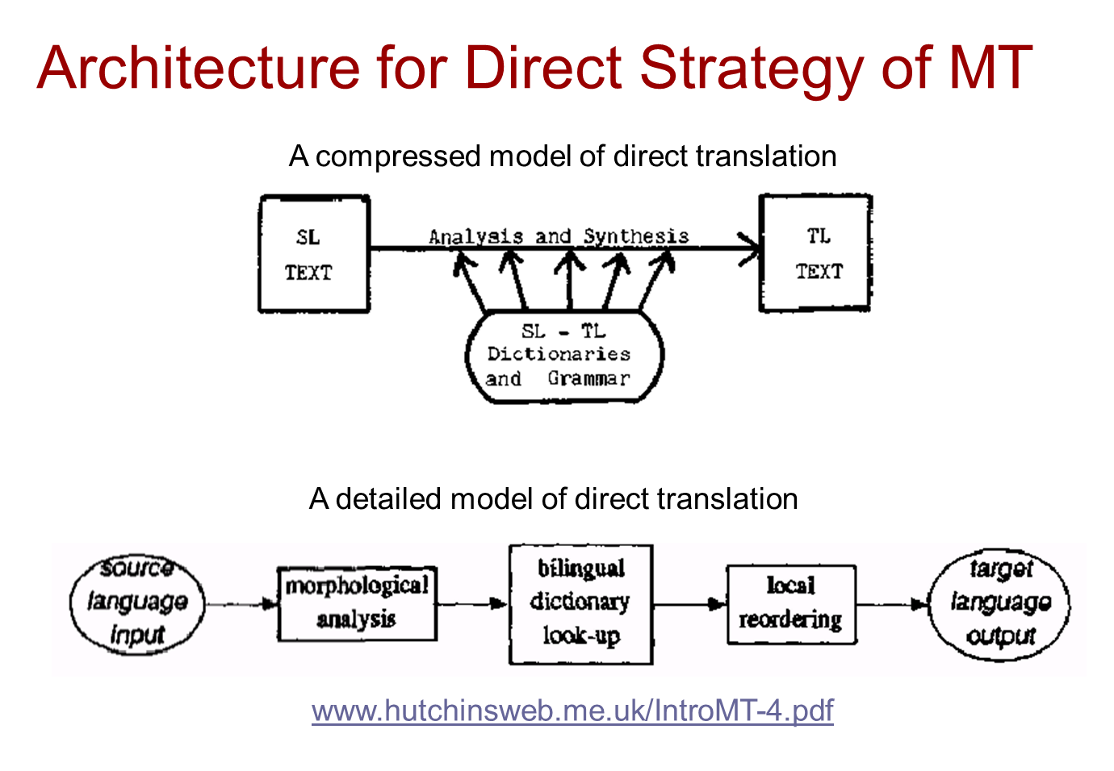

Slide 10
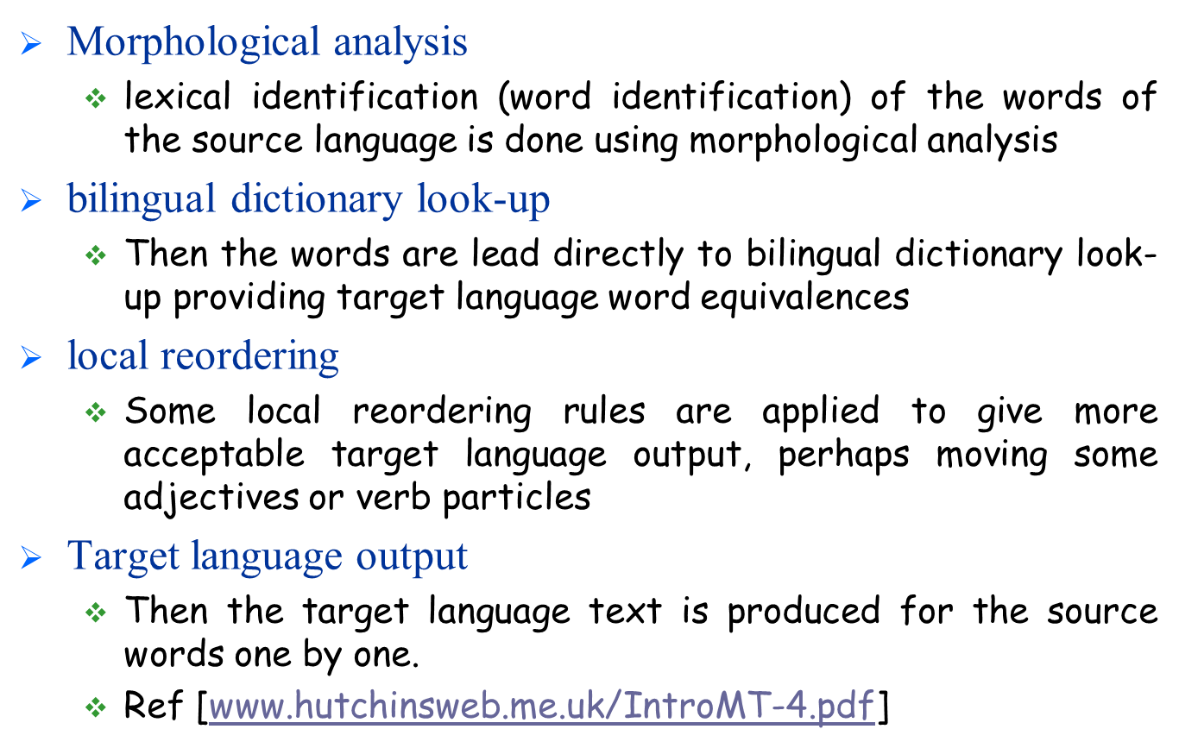
Working of Direct Strategy

Slide 11
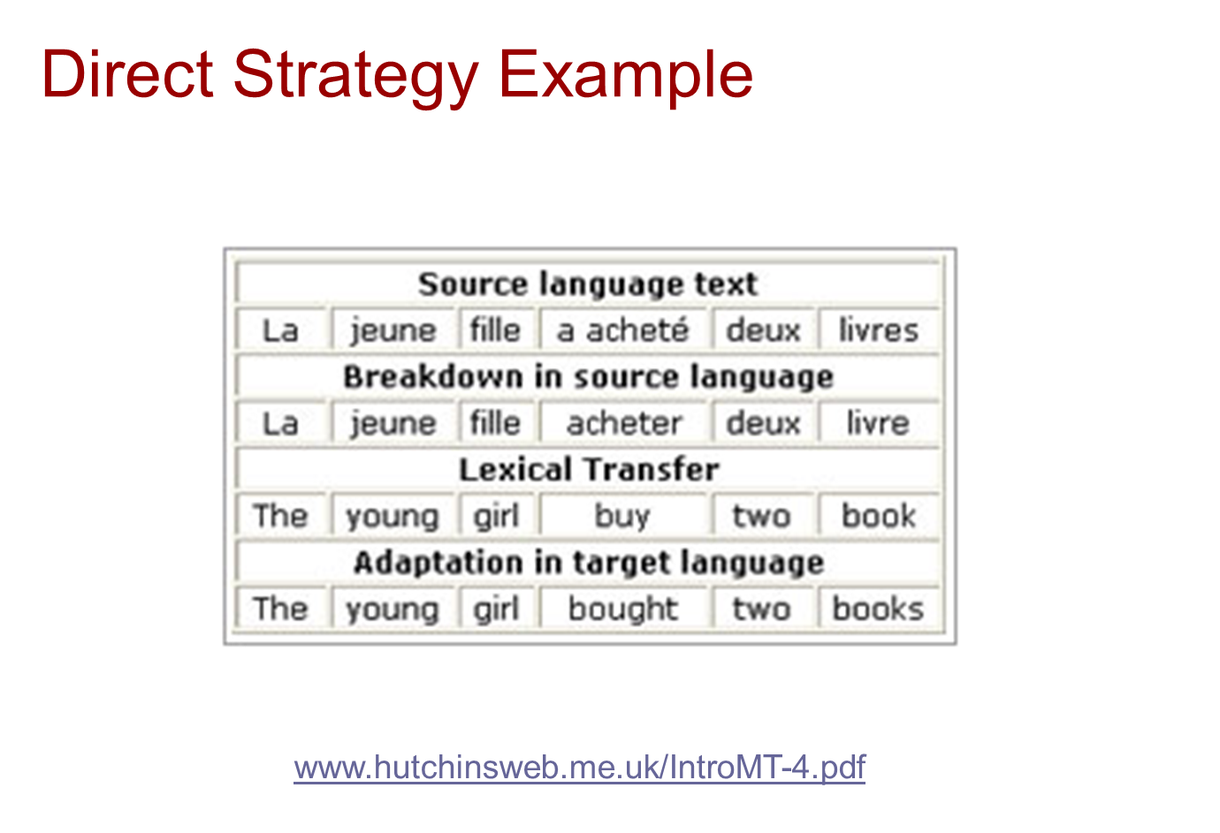

Slide 12

Ambiguity in Machine Translation
Language Divergence

Slide 13
Language Divergence
Languages have different ways of expressing meaning - this phenomenon is called Language Divergence.
Let's take an example of this: →

Slide 14
Example: (English to Hindi)
English (source): John likes Mary.
Hindi (target): ?

Slide 15
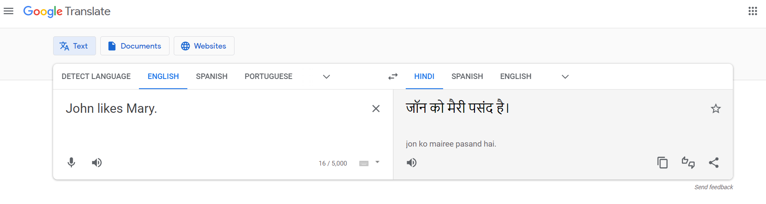
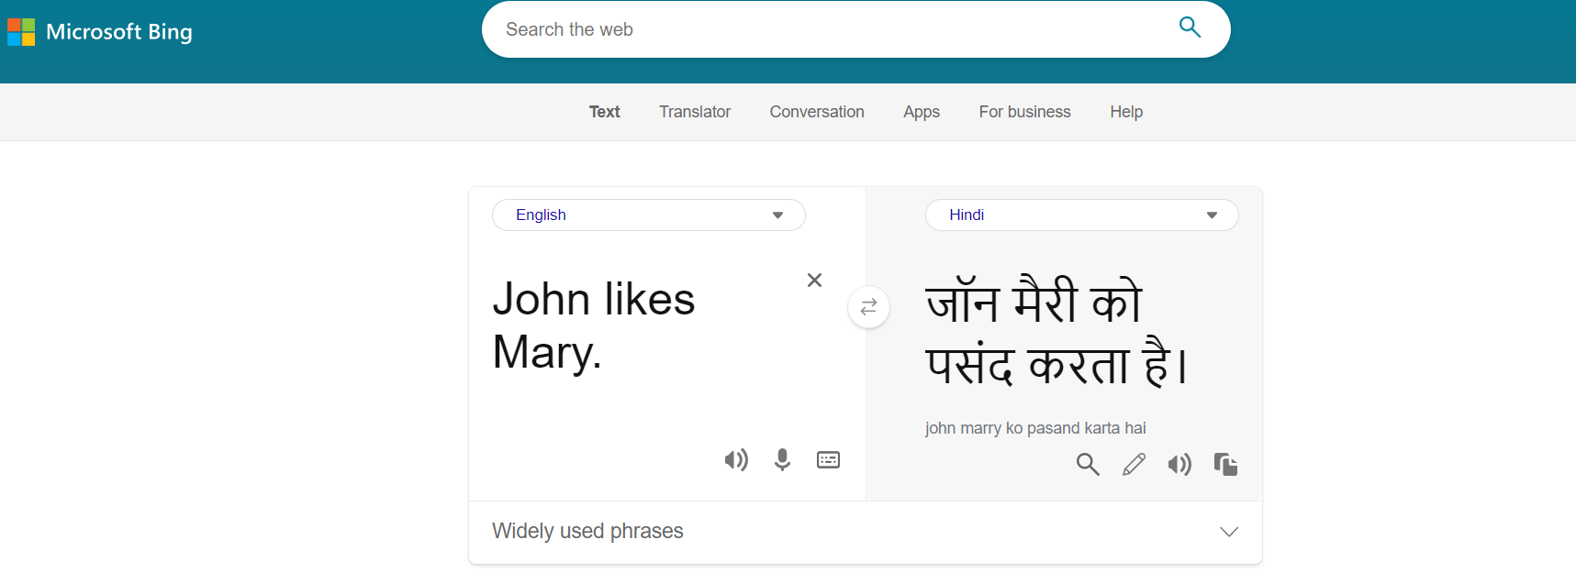
jOn mErii-ko pasand karataa hE.
jOn-ko merii pasand aaii.
jOn-ko mErii pasand hE

Slide 16
Thank you for your “ATTENTION”

